Slide 1

21st IG Meeting
South Gas Regional Initiative
Madrid, 27th February 2013

Slide 2
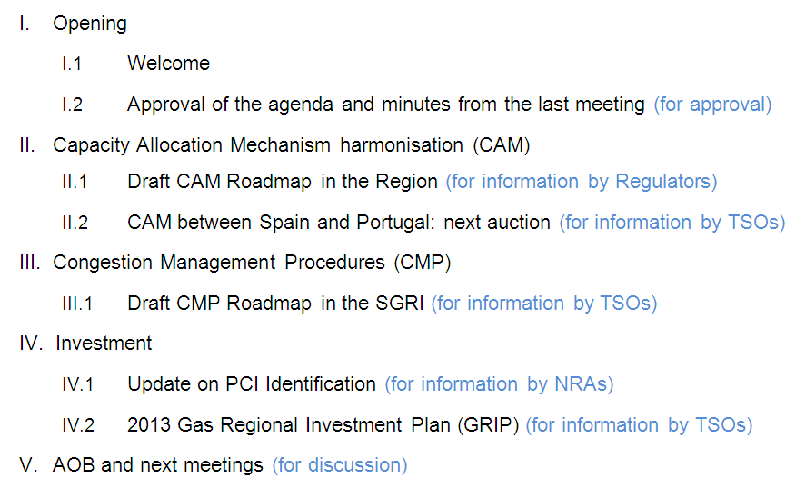
21st IG meeting SGRI- Agenda

Slide 3
II. Capacity Allocation Mechanisms Harmonization
II.1. Draft Roadmap in the Region
II.2. CAM between Spain and Portugal: next auction
Area of work | Responsible | Starting | Deadline
OSP France-Spain: annual allocation of short-term capacities | TSOs | Nov. (yearly) | Dec. (yearly)
CAM harmonisation proposal between Spain and Portugal | NRAs-TSOs | Jan. 2011 | Jun. 2012
CAM harmonisation proposal in the whole region | NRAs-TSOs | Jan.2012 | Dec.2013
Set up a common TSO Allocation Platform: Roadmap and Implementation | TSOs | Jan.2014 | Dec.2014

Slide 4
II. Capacity Allocation Mechanisms
II.1. Draft CAM Roadmap in the Region
(for information by Regulators)

Slide 5
II.1 Draft CAM Roadmap in the Region
GOAL
  Early implementation of the Draft CAM NC
  In line with the CAM NC Roadmap in Europe, developing by ACER and ENTSOG
1
2
3

Slide 6
II.1 Draft CAM Roadmap in the Region
  Capacity product definition and calendar (I)
  Definition of available bundled capacity for the next 15 years (Oct 2014...), agreement on the split of capacity (Q, yearly, 15 years)
  When will the capcity be allocated at VIP?
  Common criteria on: unbundled / interruptible / backhaul
  Monthly capacity products have been allocated by OSP until 31st March 2014
  Capacity products to be offered before March 2014 for the period April 2014-September 2014. Proposal: Maintain prorate or new CAM NC?
1
  SPAIN-FRANCE (I)

Slide 7
II.1 Draft CAM Roadmap in the Region
  Capacity product definition and calendar (II)
  Proposal of Auctions:
    Annual quarterly capacity auction in June 2014: first Q capacity products from Oct 2014 to Sept 2015 (Q1-Q4) ---- common platform
    Rolling monthly auction in Sept 2014 ?
    Daily auctions from October 2014 ?
    Annual yearly capacity auction in March 2014: first yearly capacity products from Oct 2014 (Y1-Y15)
1
  SPAIN-FRANCE (II)

Slide 8
II.1 Draft CAM Roadmap in the Region
  Capacity product definition and calendar (III)
  Definition of available bundled capacity for the next years (Oct 2014...), agreement on the split of capacity (Q, yearly, 15 years), Longest allocation period = 1 year ?
  VIP
  Common criteria on: unbundled / interruptible / backhaul
  Yearly and Monthly capacity products have been offered by auction in June 2012, from Oct 2012 to Sept 2013
  To be decided: Quarterly capacity product could be offered in June 2013 (Oct 2013-Sept 2014) the same methodology as last year?
1
  SPAIN-PORTUGA L (I)

Slide 9
II.1 Draft CAM Roadmap in the Region
  Capacity product definition and calendar (IV)
  Proposal of Auctions:
    Annual quarterly capacity auction in June 2014: Q capacity products from Oct 2014 to Sept 2015 ----- common platform for the first time
    Rolling monthly capacity auction Sept 2014 ?
    Daily auctions from October 2014 ?
    Annual yearly capacity auction in March 2014/2015: first yearly capacity products from Oct 2014/2015, for one year?
1
  SPAIN-PORTUGA L (II)

Slide 10
II.1 Draft CAM Roadmap in the Region
  Capacity product definition and calendar
  Proposal of Auctions:
1
  INSIDE FRANCE

Slide 11
II.1 Draft CAM Roadmap in the Region
1
Annual yearly auctions: 1st Monday of March / Y1: 1st Oct-31st Sept
Annual quarterly auctions: 1st Monday of June / Q1: 1st Oct-1st Jan.
Monthly capacity auctions: 3rd Monday of each month
Daily auctions: 16.30 CET D-1

Slide 12
II.1 Draft CAM Roadmap in the Region
  Regulatory needs (I)
  Auction mechanism as a default CAM in the interconnections
  Moving towards bundled and virtual capacity
  Harmonizing the capacity products and timeframes
  New regulation need to be consistent with European NC:
    CMP NC
    Balancing NC
      Agreement on nomination and renomination schemes
    Interoperability and Data Exchange NC
      Harmonization of gas day / gas year- 2014
      Temperature to measure gas- 2014
      Units used to allocate capacity and sign contracts- 2014
    Tariffs NC:
      Reserve price
      Price to be paid by subscribers during all the contract life
2

Slide 13
II.1 Draft CAM Roadmap in the Region
  Regulatory needs (II)
  To be discussed:
    Shipper license to participate in auctions process, allowing the same shipper to book unbundled capacity. Qualification steps.
    Price steps definition and allocation of revenues arising from the auction among TSOs
    Release of information to the market. Calendar
    Capacity contracts: obligation to subscribe the capacity allocated in the auction, timing, financial deposit...
    Responsibilities of TSOs (implementation) and NRAs (supervision)
    Secondary capacity market: bundled virtual capacity to remain as allocated in the auction
    Coexistence of old and new contracts
2

Slide 14
II.1 Draft CAM Roadmap in the Region
Joint European CAM platform
  IT System
  To develop a single platform to allocate capacity: Best available technologies, functionalities, secure, smooth exchange of information
  Calendar to join existent platforms by TSOs in the SGRI: European Capacity Platform / others
  TSOs to develop its own IT system to integrate the information from the capacity auctions
  TSOs to collaborate bilaterally to develop IT systems for nomination and renomination of bundled capacity, CMP implementation, exchange information for balancing process.
3

Slide 15
II.1 Draft CAM Roadmap in the Region
  Way forward
  Public consultation of this document with Stakeholders- along this week: to be launched in ACER website, comments will be welcome until 19th March 2013. (by regulators)
  Final CAM Roadmap of the SGRI – March 2013 (approval by regulators)
  Discussions and definition of the capacity products, available capacity and IT systems– March/May 2013 (to be proposed by TSOs)
  Start of the development of IT systems –Summer 2013 (by TSOs)
  National regulation modification – Starting summer 2013 (by regulators)
Discussion and definition of CAM process
May 2013
Start development of IT System
Start analysis regulation changes
Summer 2013
IT ready
Regulation in place
Draft MOUs
December 2013

Slide 16
II.1 Draft CAM Roadmap in the Region
  Way forward (cont.)
  Available capacity, Products, and IT systems. First draft to be presented in the next SG meeting (24th April).
    Available capacity in all borders, for the next 15 years, and proposal of capacity split for the different auctions, from October 2014: virtual Point between Spain and Portugal, physical/virtual point between France and Spain, and inside France ( to be sent by TSOs to regulators before 15th March) .
    IT development (to be sent by TSOs before 29th March)
      Capacity allocation platform utilisation: what capabilities...
      TSOs IT systems: what need to be developed and when, interface to support primary and secondary capacity markets, nomination and renomination schemes...

Slide 17
II.1 Draft CAM Roadmap in the Region
  Way forward (cont.)
  Available capacity, Products, and IT systems. First draft to be presented in the next SG meeting (24th April).
    Products:
      Long term vision of the whole process: ( proposals to be sent by TSOs before 24th April)
        Bundled, virtual auctions simultaneously conducted in the whole region
        Definition of the auction mechanism ( reserve price, price steps, rounds, allocation of revenues...)
        Decision to be made prior to the auction announcement ( financial deposit, obligation to subscribe capacity, contracts, shippers licence...)
        Interruptible capacity
        Unbundled capacity offer?
      Short – term decisions on the initial products and the calendar ( proposals to be sent by TSOs before 10th May)
        Interoperability amendments needed: (gas day, gas year, amendment of gas quality measurement and calendar)
        Decision on the Larrau capacity to be sold before March 2014, in two quarters, from April 2014 to September 2014. Pilot of the IT system in late 2013, early 2014?
        Allocation of yearly capacity in all borders in March 2014, quarterly capacity in June 2014, monthly capacity in September 2014...

Slide 18
II. Capacity Allocation Mechanisms
II.2. CAM between Spain-Portugal. Next auction
(for information by TSOs)

Slide 19
II.2 CAM between Spain-Portugal. Next auction
  ENAGÁS and REN are developing the procedure of the 2nd annual auction
  Issues already decided:
  Capacity Products to be offered for the gas year 1st Oct 2013 to 30th Sept 2014:
    Firm yearly products
    Firm quarterly products
    Interruptible products if more than 95% of firm capacity has been allocated at the previous firm products auctions
  Issues to be decided: IT system to allocate capacity?
  To be proposed by TSOs by mid March

Slide 20
II.2 CAM between Spain-Portugal. Next auction
  National regulations to be approved in advance in order stakeholders will be timely informed:
  Resolución CNE on methodology for the coordinated capacity allocation at the IP between Spain and Portugal.
  Mecanismo de atribuição de capacidade da RNTGN - ERSE
  Information Memorandum and Standard Contracts: to be elaborated by TSOs describing the procedures for the annual auction (following the Draft CAM NC): rules, price steps, reserve price, capacity offered, application form, contract information, calendar…. To be approved by NRAs.

Slide 21
II.2 CAM between Spain-Portugal. Next auction
  CALENDAR for the 2nd annual auction between Spain and Portugal
2013
Feb | Mar | Apr | May | Jun | Jul | Aug | Sep | Oct | Nov | Dec
27: 21thIG |  | 24: 20thSG |  | 12: 22thIG
Issues to be decided
Coordination
NRAS
TSOs
NRAs/TSOs
Development of National regulations
3rd June 2013 (first Monday-quarterly auctions)
Info Memo
IT system: development/ tests/formation/implementation
Stakeholders involvement
REGULATION APPROVAL

Slide 22
III. Congestion Management Procedures
III.1. Draft CMP Roadmap in the Region
Area of work | Responsible | Starting | Deadline
CMP harmonization in the whole region | NRAs-TSOs | Oct. 2012 | Oct. 2013
CMP harmonization in the whole region (including UIOLI firm ST) | NRAs-TSOs | Oct. 2012 | Jul. 2016

Slide 23
III. Congestion Management Procedures
III.1. Draft CMP Roadmap in the Region
RCC meeting to discuss CMP the 13th March
IG meeting at the end of March to share main ideas regarding CMPs. TSOs to propose preliminary Roadmap (videoteleconference)
TSOs to send a final CMP Roadmap agreed by the four TSOs in May

Slide 24
IV. Investment
IV.1. Update on PCI Identification
IV.2. 2013 Gas Regional Investment Plan (GRIP)
Area of work | Responsible | Starting | Deadline
Regular update and publication in CEER website of project status of OS 2013 and 2015 | TSOs-NRAs | Dec. (yearly) | Jun. (yearly)
Drafting of the South Regional Investment Plan 2012 | TSOs | Jul. 2011 | Jan. 2012 (COMPLETED)
Feedback to ENTSO-G on contents and methodology of the regional investment plan | NRAs | Jan. 2012 | Jul. 2012 (COMPLETED)
Input to ENTSO-G for the Community-wide TYNDP 2013 | TSOs | Jan. 2012 | Apr. 2013
Creation of a working group in the region in order to test the process of PCI identification | NRAs -TSOs | Mar. 2012 | March 2013
Drafting of the South Regional Investment Plan 2014 | TSOs | Jan. 2013 | Apr. 2014

Slide 25
IV. Investment
IV.1. Update on PCI Identification
(for information by Regulators)

Slide 26
IV.1. Update on PCI Identification
North-South Gas Interconnections in Western Europe
  6th meeting held on 18 January: Previous meeting organized by EC with NRAs with the aim to know NRAs’ opinion. Summary on NRAS’ opinion on impact areas
  Main rule: a project must impact on at least two Member States to be eligible
  Clusters: projects considered in a cluster represent just one PCI.
  Presentation of analysis of qualitative and quantitative assessment carried out by consultants, as well as a preliminary PCIs list
  Main comments from attendants: impact areas, quantitative assessment (formulas application, parameters used, inputs, etc.). As a result, new calculations are being considered and a new list will be elaborated
  Participants were given time to send their opinion on impact areas and clusters
  Next meeting to be held on 7th March 2013.

Slide 27
IV.1. Update on PCI Identification
North-South interconnections in Western Europe

Slide 28
IV.1. Update on PCI Identification
North-South interconnections in Western Europe

Slide 29
IV.1. Update on PCI Identification
North-South interconnections in Western Europe

Slide 30
IV. Investment
IV.2. 2013 Gas Regional Investment Plan (GRIP)
(for information by TSOs)

Slide 31
V. AOB and next meetings

Slide 32
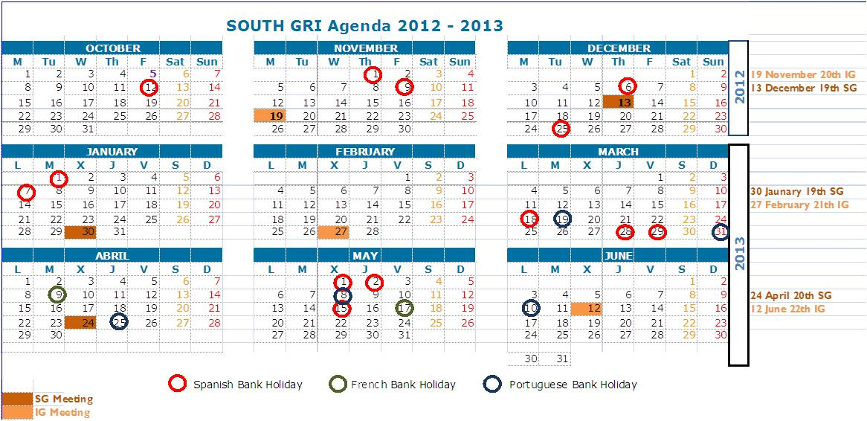
Meetings calendar for the first semester 2013
Next meetings:
25th March, 15:00 CET , 22th IG (videoconference)
24th April: 20th SG
12th June: 23th IG

